Slide 1
MARIE COMPUTER
Microprogrammed Control Unit
ALU
Bus System
Presented by
Deekshita Athreya (22BCE062)
Vashita Darji(22BCE056)
Ansh Bhavsar (22BCE019)
Sezan Agvan (22BCE012)

Slide 2

Introduction to MARIE
MARIE ('Machine Architecture that is Really Intuitive and Easy') is a machine architecture and assembly language served only for educational purposes.
In addition, the publisher provides a set of simulator programs for the machine, written in Java.
MARIE.js is a JavaScript version implementation of MARIE. It aims to be as faithful to the original Java programs as it can, while improving on features to make concepts more intuitive and easier to understand.

Slide 3
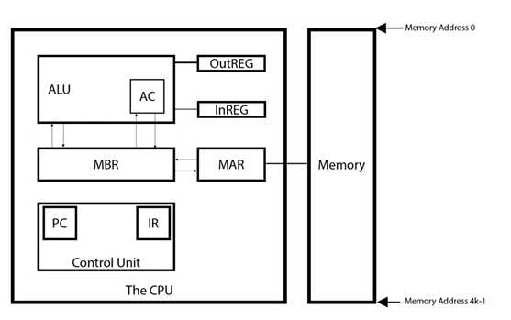
Registers in MARIE
AC or Accumulator intermediate data is stored within the AC
PC or Program Counter as the name suggests it stores the current position of the instruction, with each instruction having its own address
MAR or Memory Access Register stores or fetches the 'data' at the given address
MBR or Memory Buffer Register stores the data when being transferred to or from memory
IR or Instruction Register: holds the current instruction

Slide 4
Memory and Instruction Formats
RAM
Program Instruction
Opcode
Address
4096 X 16
4
12
ROM
Micro Instruction
F
CD
BR
Address
128 X 15
4
2
2
7

Slide 5
MARIE Instruction Set
In MARIE, each instruction is 16 bits long with the first 4 bits representing the opcode and the remaining 12 bits are being used to represent the address.
Type | Instruction | Hex Opcode | Summary
Arithmetic | Add X | 3 | Adds value in AC at address X into AC, AC ← AC + X
 | Sub X | 4 | Subtracts value in AC at address X into AC, AC ← AC - X
 | Addl X | B | Add Indirect: Use the value at X as the actual address of the data operand to add to AC
 | Clear | A | AC ← 0
Data Transfer | Load X | 1 | Loads Contents of Address X into AC
 | Store X | 2 | Stores Contents of AC into Address X
Branch | Jump X | 9 | Jump to Address X
Subroutine | Jns X | 0 | Jumps and Store: Stores PC at address X and jumps to X+1
 | Jumpl X | C | Uses the value at X as the address to jump to
Indirect Addressing | Storel | E | Stores value in AC at the indirect address. e.g. StoreI addresspointer
 | Loadl | D | Loads value from indirect address into AC e.g. LoadI addresspointer

Slide 6
Register Transfer Language
DIRECT ADDRESSING
LOAD X: Load X loads the value from address X into the AC.
MAR ← X # load X (address) into MAR
MBR ← M[MAR] # load value stored at address into MBR
AC ← MBR # load value in MBR into AC
Store X: Store X stores the current value from the AC into address X.
MAR ← X # load address into MAR
MBR ← AC # load AC value into MBR
M[MAR] ← MBR # writes MBR value into the Memory of address indicated by the MAR
Add X: Add X adds the value stored at address X into AC
MAR ← X # load X into MAR
MBR ← M[MAR] # load value stored at address X into MBR
AC ← AC + MBR # add value in AC with MBR value and store it back into AC

Slide 7
Register Transfer Language
SUBT X: Subt X subtracts the value in AC with the value stored at address X.
MAR ← X
MBR ← M[MAR]
AC ← AC - MBR
Jump X: Jump X jumps to address X .
PC ← X
INDIRECT ADDRESSING
LoadI X : LoadI X loads the value which is stored at address of the address X into the AC.
MAR ← X # load value X into MAR
MBR ← M[MAR] # load value stored at address X into MBR
MAR ← MBR # load value back into MAR (MAR cant write itself)
MBR ← M[MAR] # load value into MBR stored at the address indicate by MAR
AC ← MBR # Load value into AC

Slide 8
Register Transfer Language
JnS X: JnS X or Jumps and Stores: Stores PC at address X and jumps to X+1.
MAR ← X # loads value X into MAR
MBR ← PC + 1 # loads value of PC into MBR
M[MAR] ← MBR # stores value in MBR into address of MAR
AC ← X + 1 # increments X by 1 and stores it into AC
PC ← AC # jumps program counter to address indicated by AC
JumpI X: JumpI X uses the value at X as the address to jump to
MAR ← X # loads value X into MAR
MBR ← M[MAR] # loads value stored at address X into MBR
MAR ← MBR # loads value back into MAR
MBR ← M[MAR] # fetches the value at the address into MBR
PC ← MBR # loads the value into PC

Slide 9
Subroutines
A subroutine is a sequence of instructions that is modular and can be executed multiple times.
MARIE doesn't provide a way to specify input or output values (for programmers, parameter or return values). MARIE provides a way to call these subroutines by using the JnS instruction, and normal program execution can be resumed once the subroutine exits by using the JumpI instruction.
Here is an example that prints the variable X, then halts the program:
/ Enter subroutine PrintVariableX
JnS PrintVariableX
Halt
PrintVariableX, HEX 000 / Used for storing return address
Load X
Output
/ Exit subroutine PrintVariableX
JumpI PrintVariableX
X, DEC 42

Slide 10
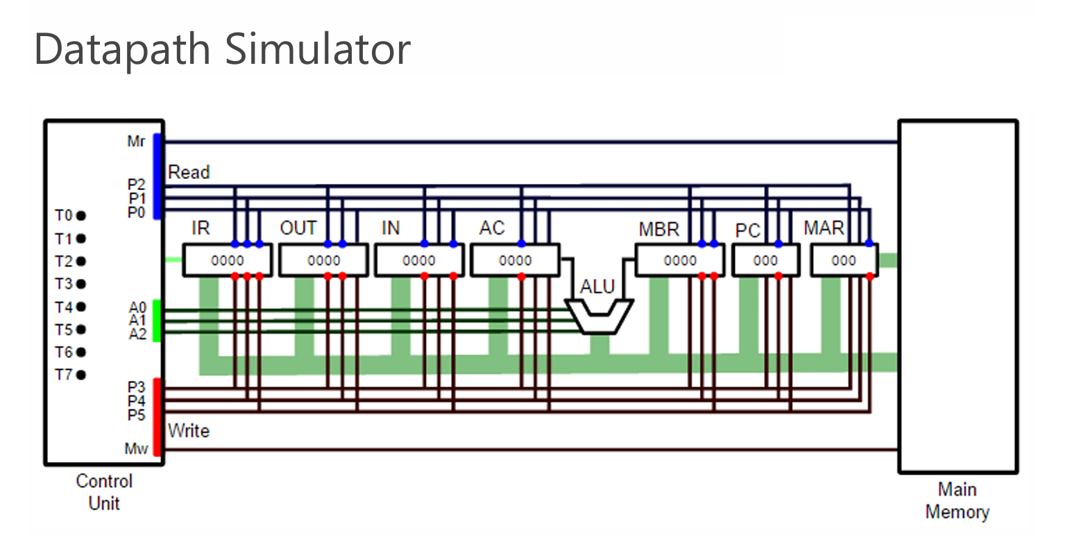
Datapath Simulator
The datapath simulator is incorporated into MARIE.js, and can be accessed via the menu: View → Datapath.
The purpose of this visualisation is to give an understanding of how instructions and micro instructions relate to sequence of physical signals.

Slide 11
Register bank
The MARIE simulator register bank is a set of 7 registers used for different purposes
Name | Opcode | Abbreviation | # of bits stored
Memory Address Register | 001 | MAR | 12
Program Counter | 010 | PC | 12
Memory Buffer Register | 011 | MBR | 16
Accumulator | 100 | AC | 16
Input | 101 | IN | 16
Output | 110 | OUT | 16
Instruction Register | 111 | IR | 16

Slide 12
Read Control Bus
The read control bus tells which register (or memory) to output data into the data bus.
* While the memory opcode is 000, it technically means that we do not want to access any register. This is the reason why we have a separate memory read wire so that we can tell the memory exactly when we want to fetch the contents of one memory cell.
Abbreviation | Opcode | Active Wires
M[MAR] | 000* | Mr
MAR | 001 | P0
PC | 010 | P1
MBR | 011 | P1 P0
AC | 100 | P2
IN | 101 | P2 P0
OUT | 110 | P2 P1
IR | 111 | P2 P1 P0

Slide 13
Write Control Bus
The write control bus tells which register (or memory) to read from the data bus and override its value.
* 000 opcode just means do not write to any register. A separate memory write wire is activated instead when we need to write to memory.
Abbreviation | Opcode | Active Wires
M[MAR] | 000* | Mr
MAR | 001 | P3
PC | 010 | P4
MBR | 011 | P4 P3
AC | 100 | P5
IN | 101 | P5 P3
OUT | 110 | P5 P4
IR | 111 | P5 P4 P3

Slide 14
Control Unit
The control unit handles both the register bank, the memory, and the ALU. It does this by generating a sequence of signals, depending on what instruction it has decoded.
All instructions begin with the fetch cycle, which the control unit fetches the next instruction from memory, and increments the program counter.
Once the instruction is fetched, it executes the instruction by performing the corresponding sequence of micro operations. Each micro operation has its own set of signals that needs to be generated.
These sequential signals are reset once the control unit has finished executing the current instruction and is ready to execute the next instruction.
The first five (T0, T1, T2, T3, T4) time sequence signals are dedicated to the fetch part of the fetch decode-execute cycle. The rest of the time sequence depends on what instruction the control unit has decoded from the IR.

Slide 15
Defined Micro operations
0000 | NOP
0001 | MBRTAC
0010 | ACTMBR
0011 | ADD
0100 | PCTAR
0101 | READ
0110 | INCPC
0111 | SUB
1000 | IRTAR
1001 | MBRTIR
1010 | WRITE
1011 | CLR
1100 | MARTPC
1101 | PCTMBR
1110 | RESERVED
1111 | RESERVED

Slide 16
Control Signals
Read Signals:
PC: a’bc’d’+abc’d’
MAR: abc’d’
MBR: a’b’c’d+ab’c’d+ab’cd’+ab’cd’
IR: ab’c’d’
AC: a’b’cd’
Memory: a’bc’d
Write Signals:
PC: abc’d’
MAR: a’bc’d’+ab’c’d’
MBR: a’b’cd’+abc’d+a’bc’d+a’bc’d
IR: ab’c’d
AC: a’b’cd
Memory: ab’cd’
ALU: a’b’cd+a’bcd
INC PC: a’bcd’
CLR AC: ab’cd

Slide 17
THANK YOU

